Slide 1
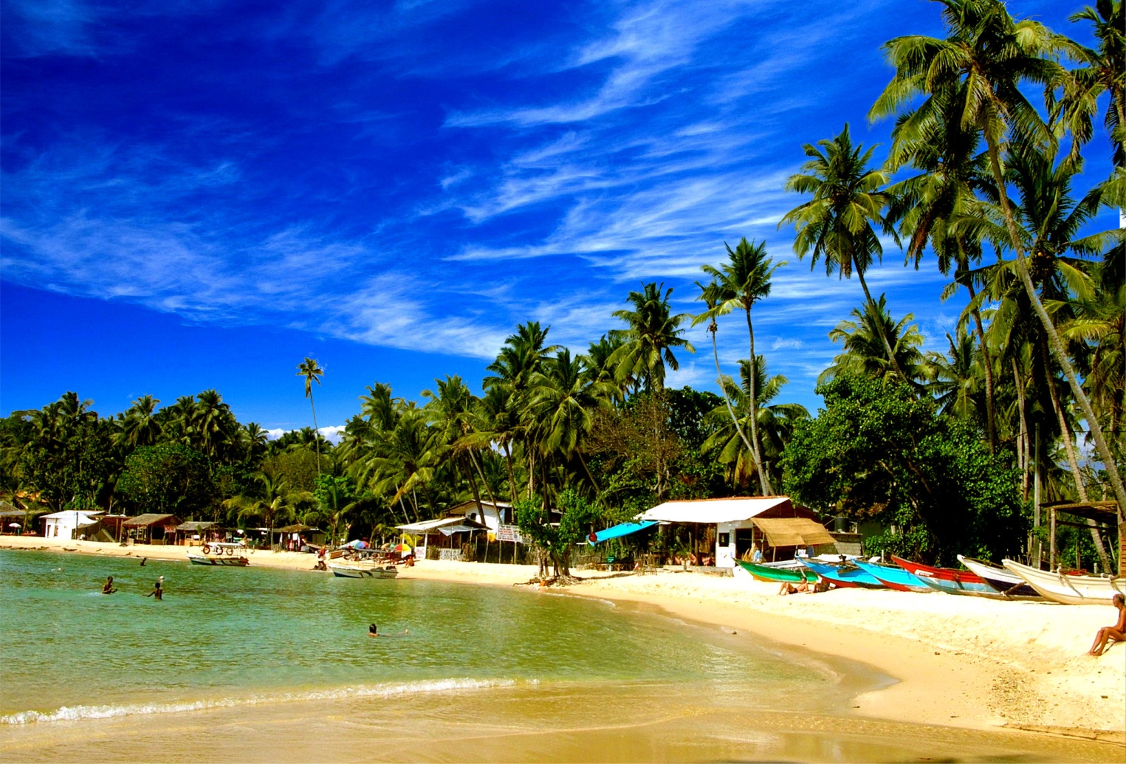
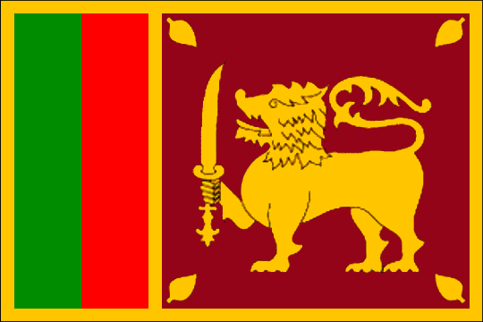
Sri Lanka - your adventure starts here!

Slide 2
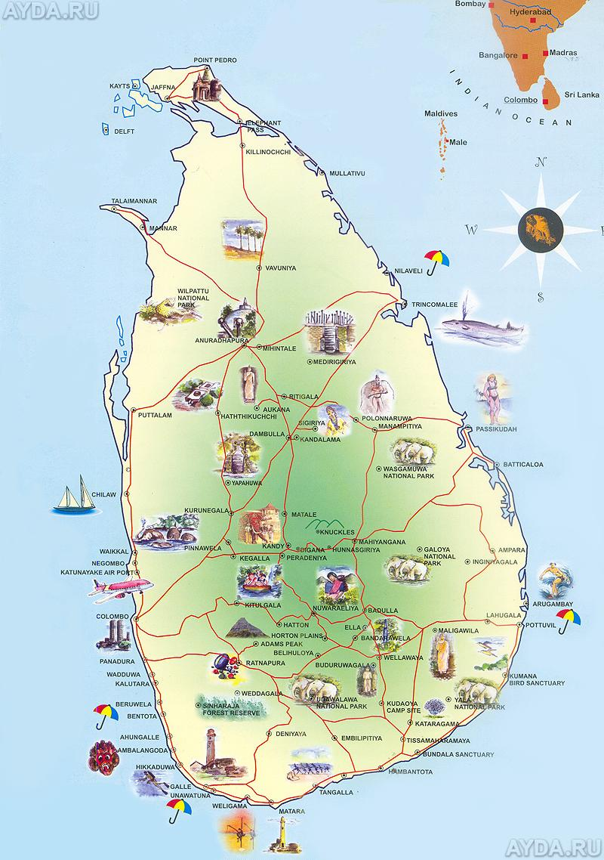
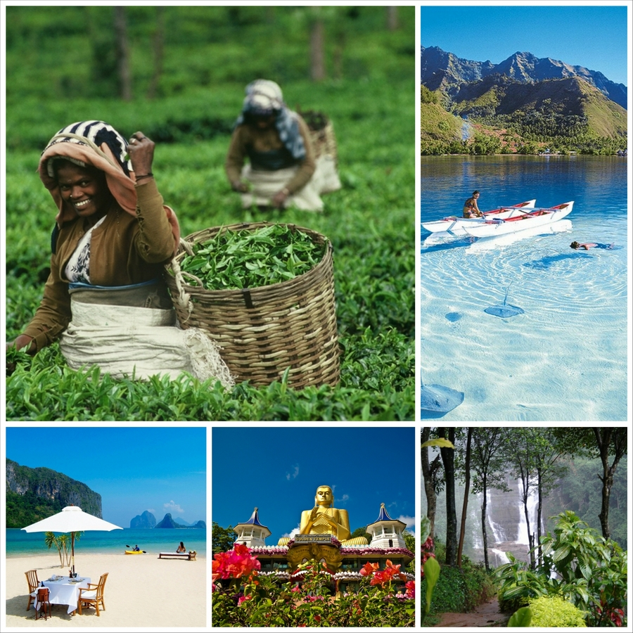
5-DAY TOUR TOUR OF THE FAMOUS MUST-VISIT ISLAND!

Slide 3
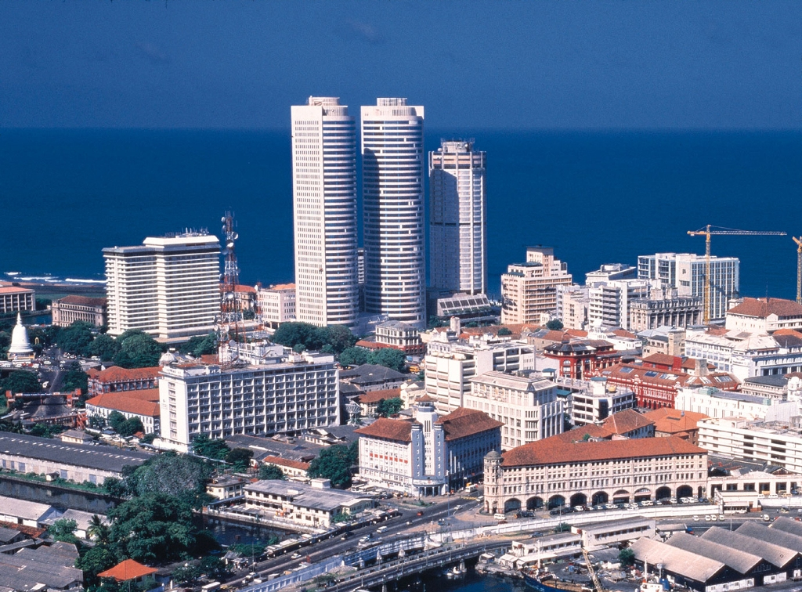
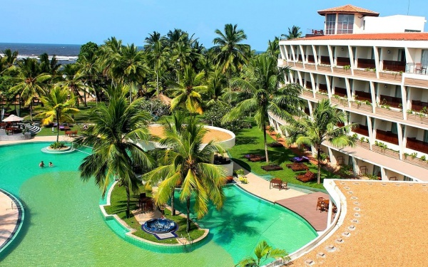
DAY 1
Colombo city

Slide 4
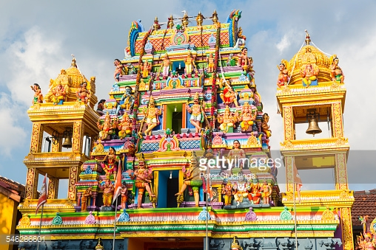
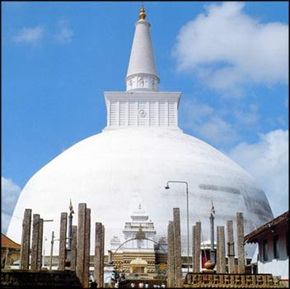
HINDU TEMPLE
BUDDHIST TEMPLE

Slide 5
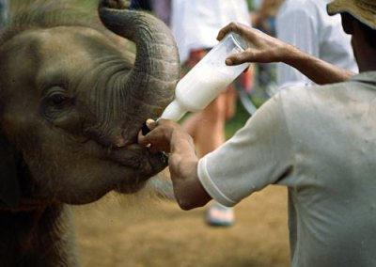
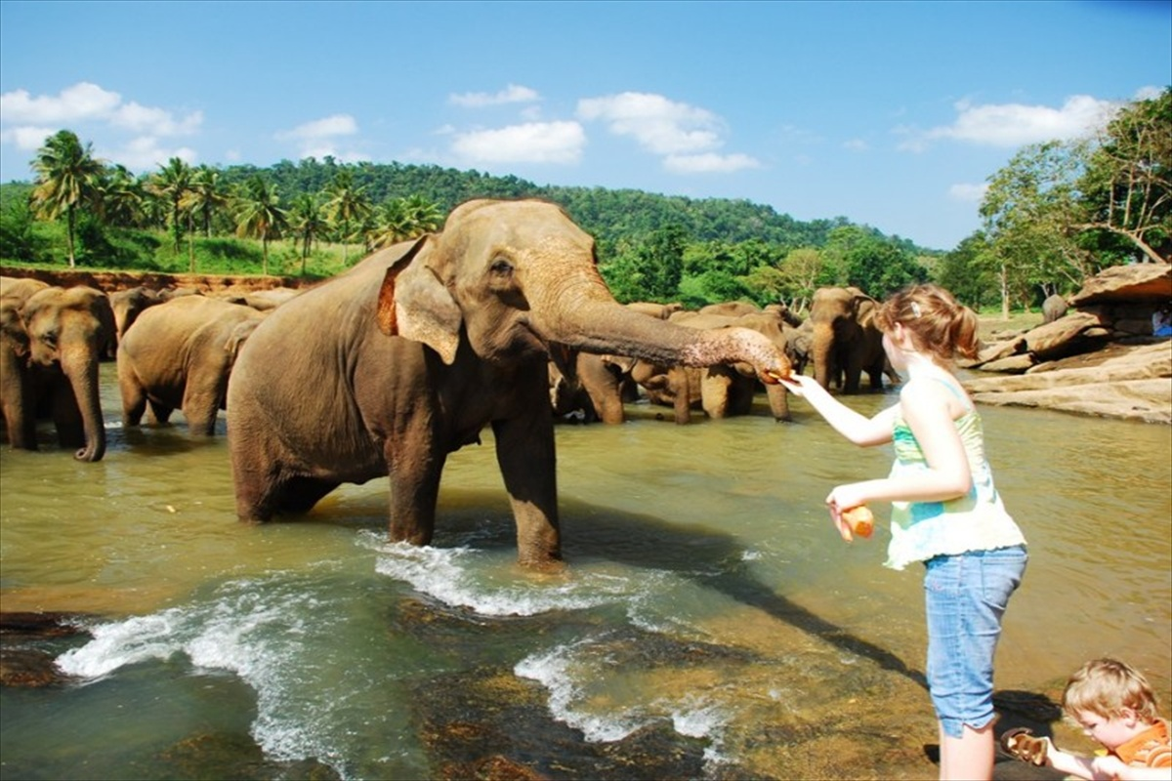
DAY 2
ELEPHANT ORPHANAGE
IN PINNAWALA

Slide 6
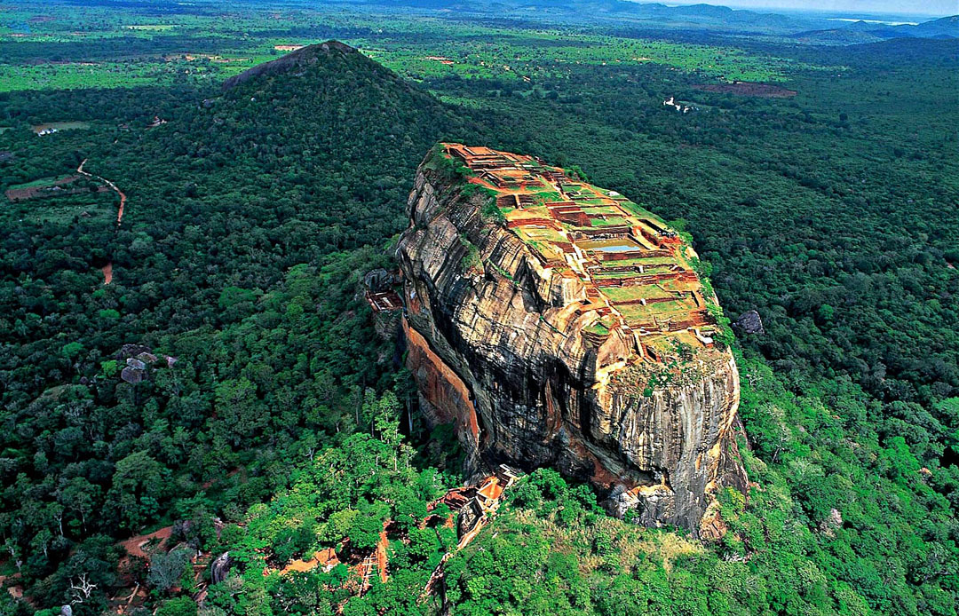
SIGIRIYA MOUNT

Slide 7
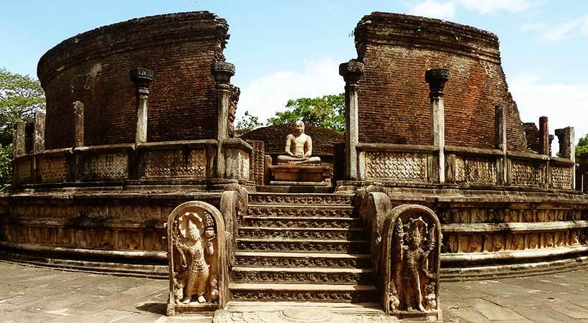
DAY 3
THE MEDIEVAL CAPITAL OF POLONNARUWA

Slide 8
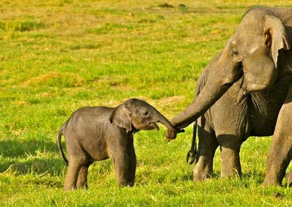
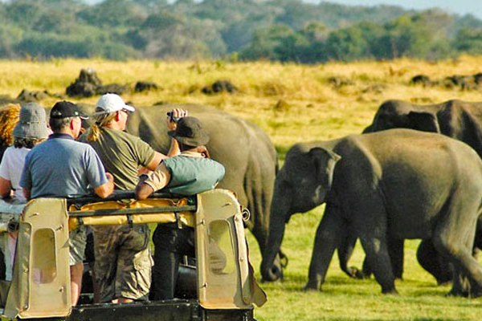
SAFARI AT MINNERIYA NATIONAL PARK

Slide 9
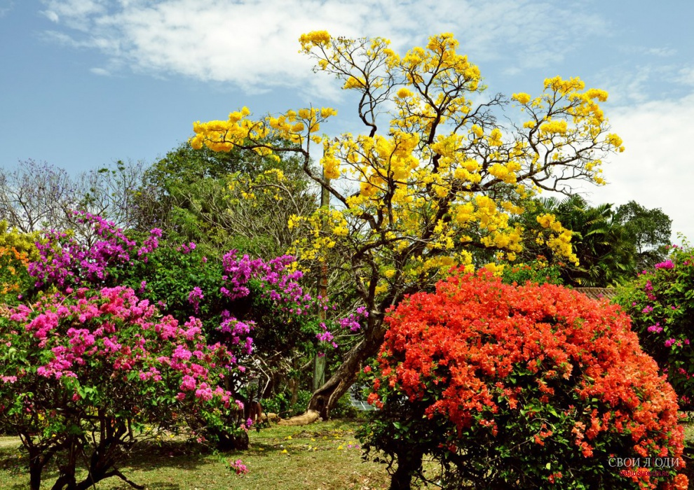
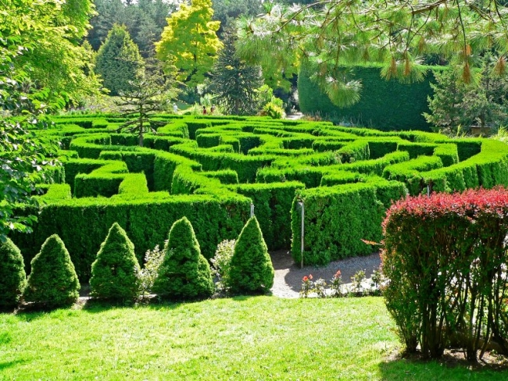
DAY 4
ROYAL
BOTANICAL GARDEN

Slide 10
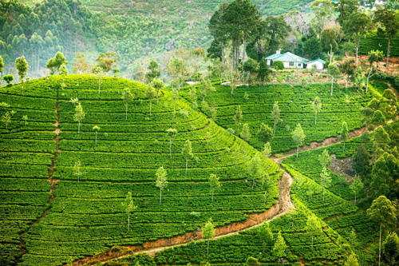
NUWARA ELIYA

Slide 11
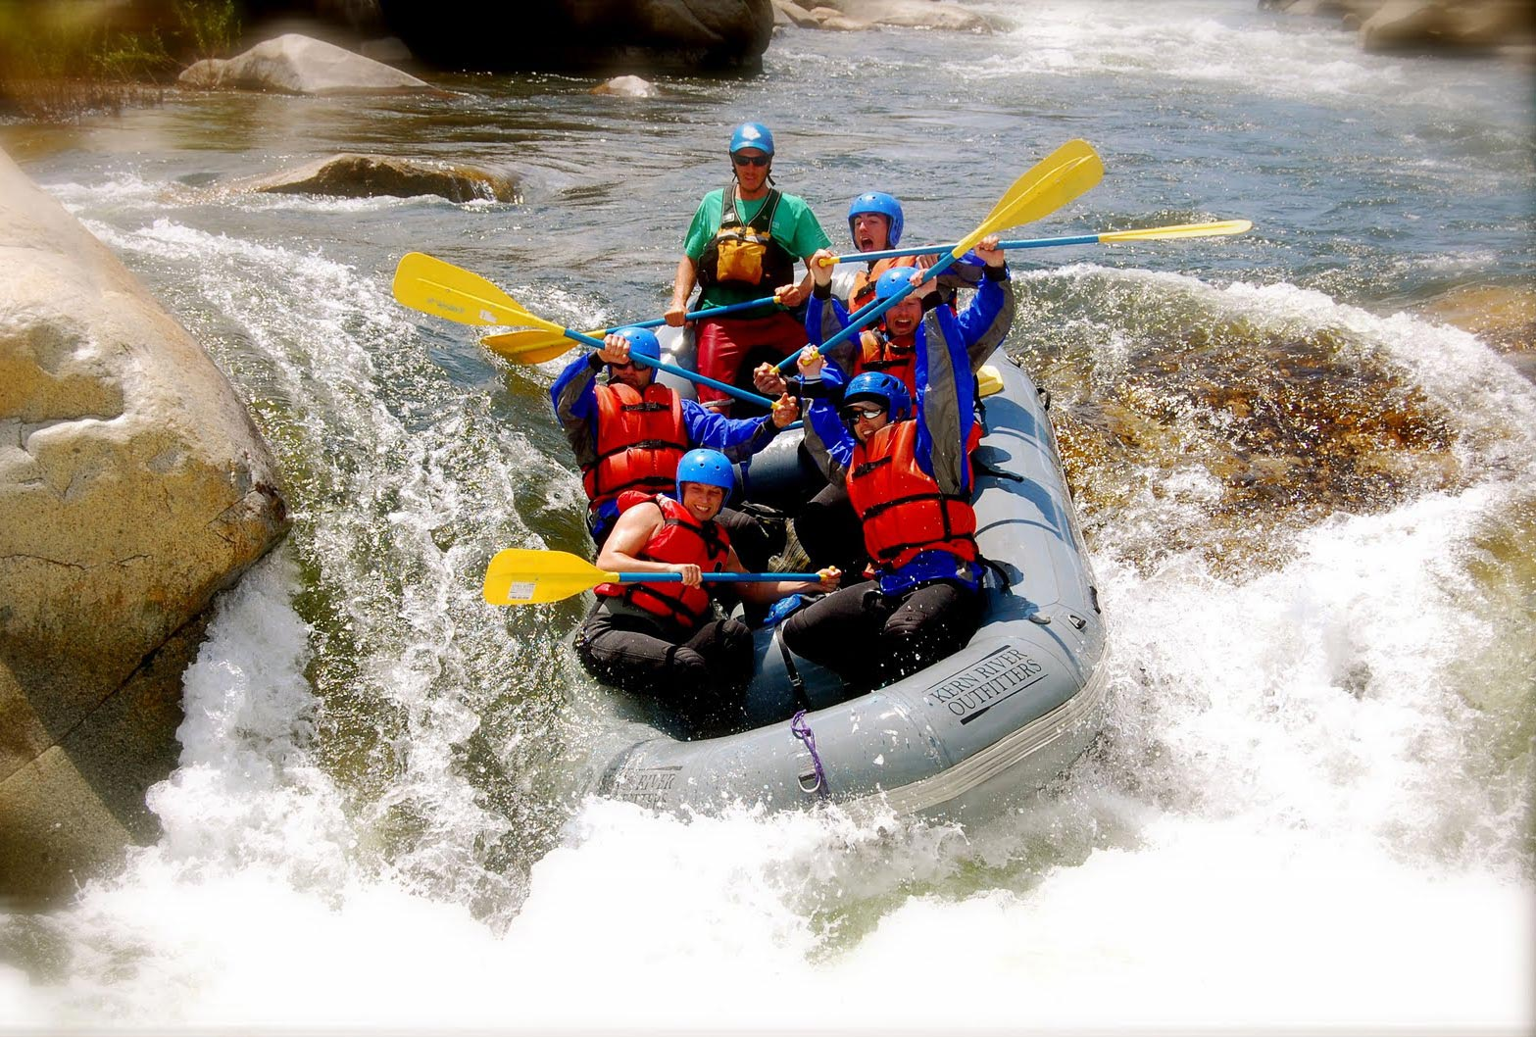
DAY 5
RAFTING ON THE KALANI RIVER

Slide 12
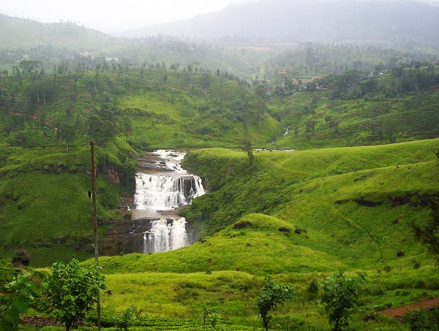
WATERFALLS OF ST CLAIR AND DEVON

Slide 13
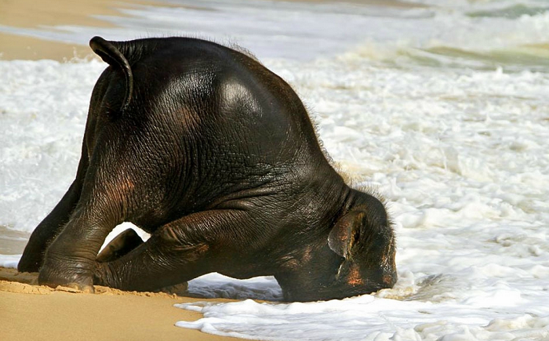
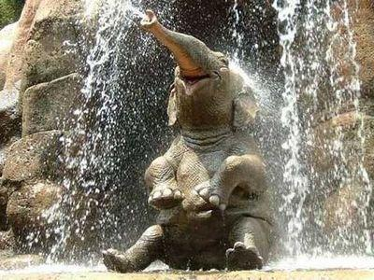
SRI LANKA IS WAITING FOR YOU!
Before the holiday to Sri Lanka…
And after!!!

Slide 14
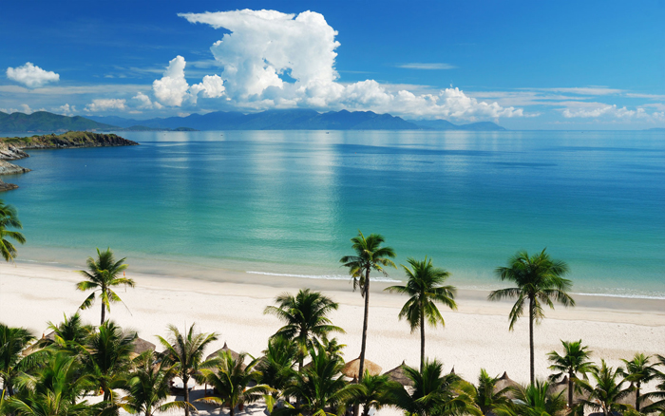
Thank you for your attention!

