Slide 1
urban expansion
Kirillov Alexandr

Slide 2
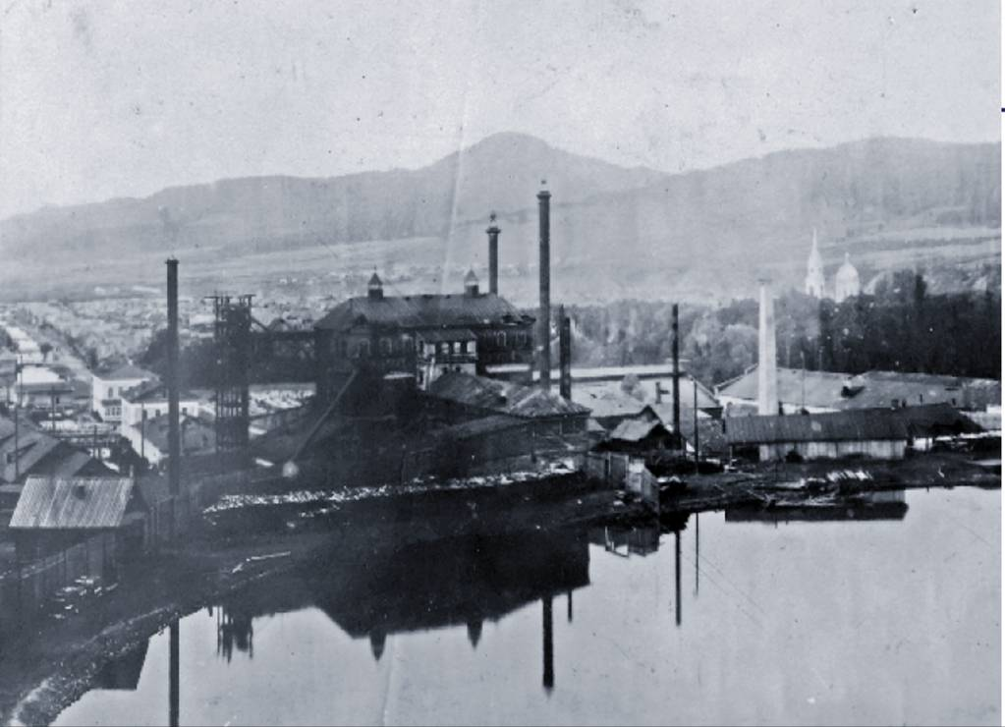
Jefferson 1853 United States

Slide 3
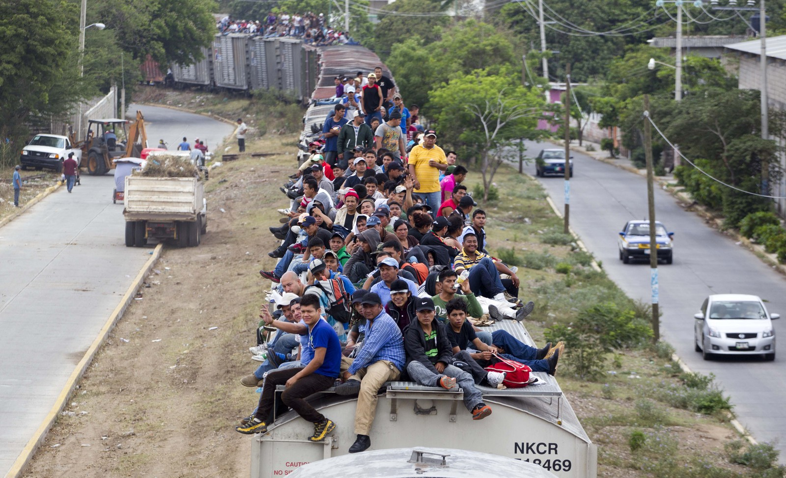
Mexican migrants

Slide 4
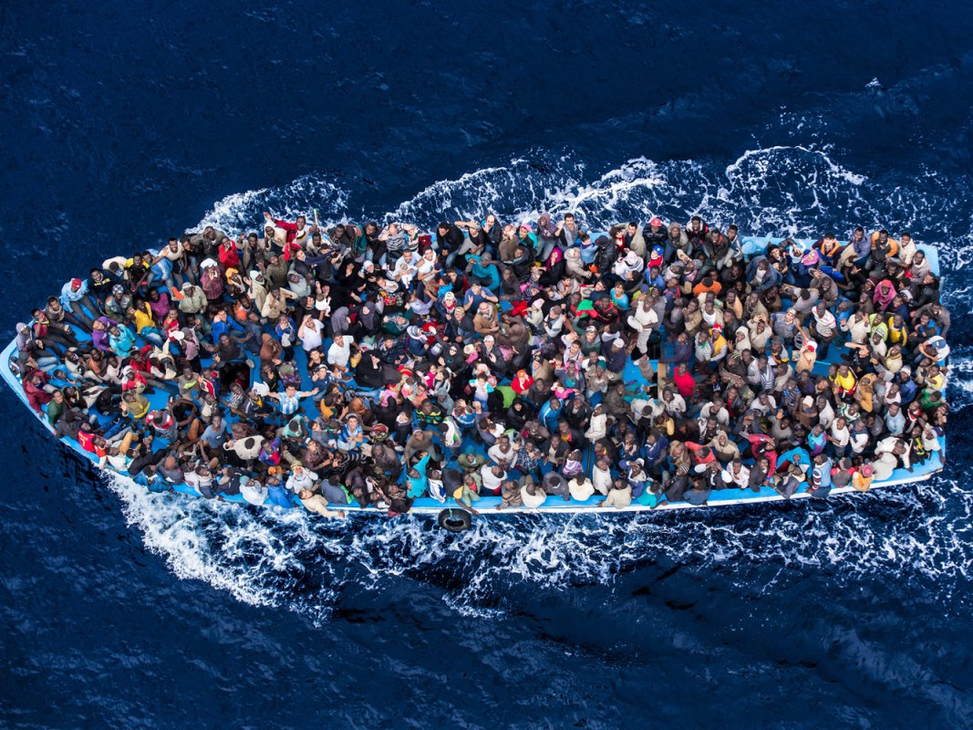
Mexican migrants

Slide 5
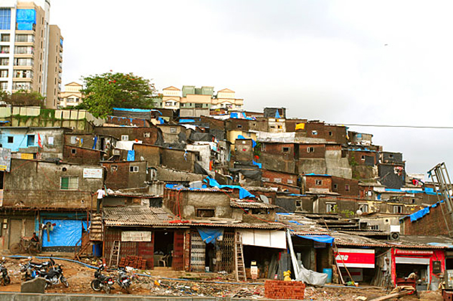
Slum Mumbai

Slide 6
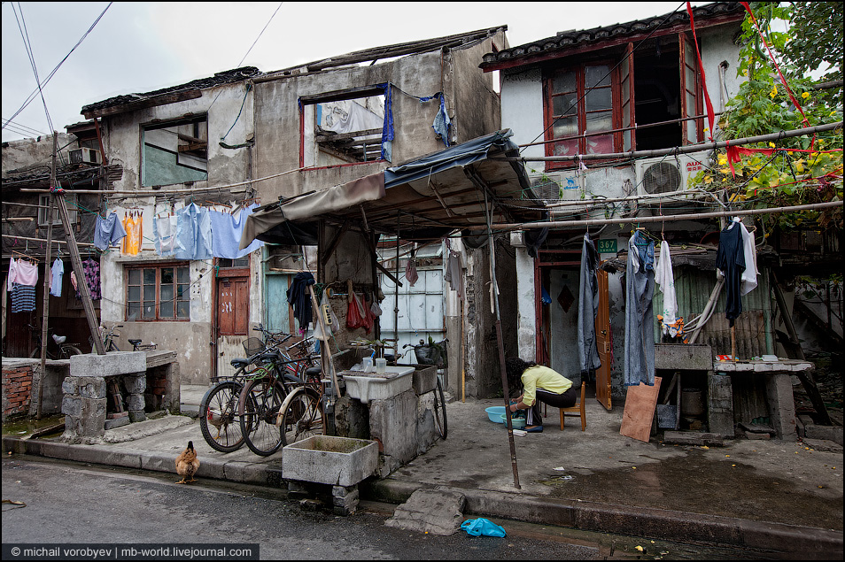
Life in the slums

Slide 7
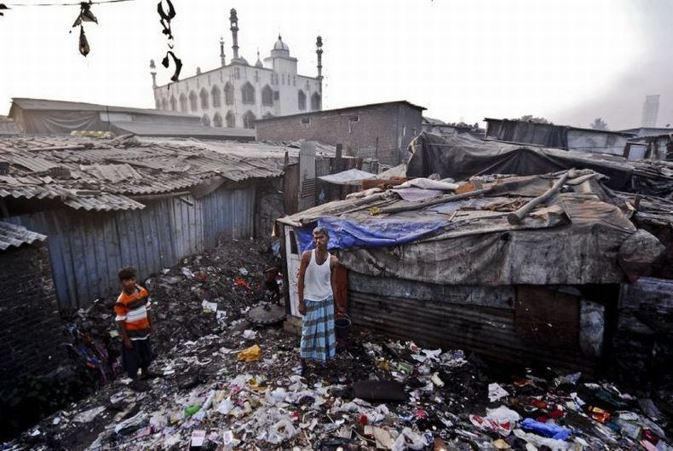
playground

Slide 8
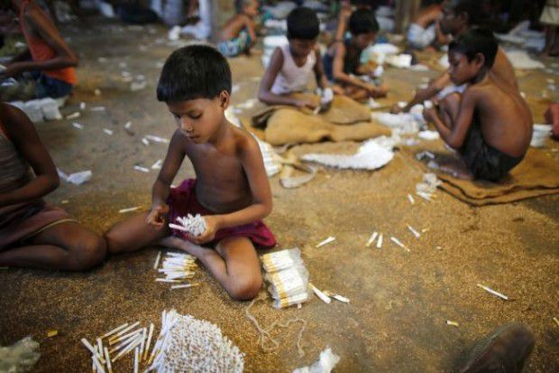
child Labour

Slide 9
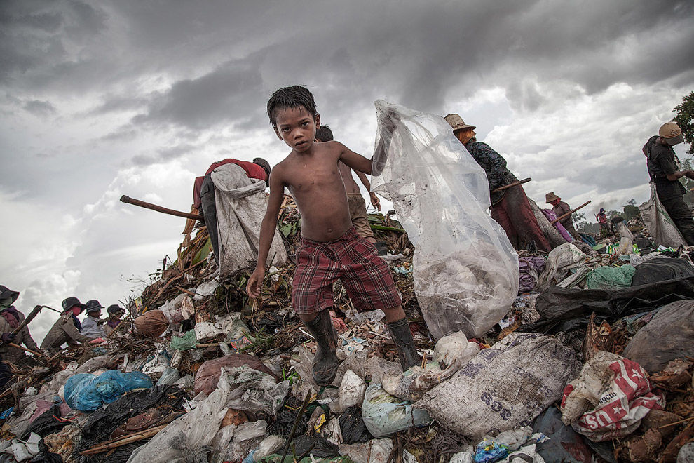
search Clothing

Slide 10
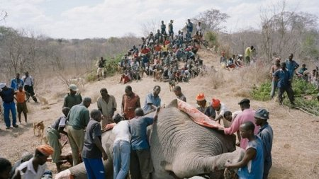
hunting for food

Slide 11
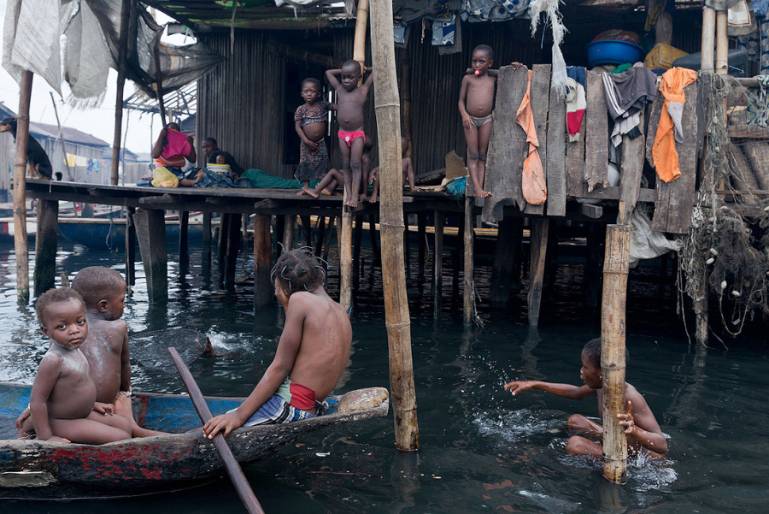
games near the house

Slide 12
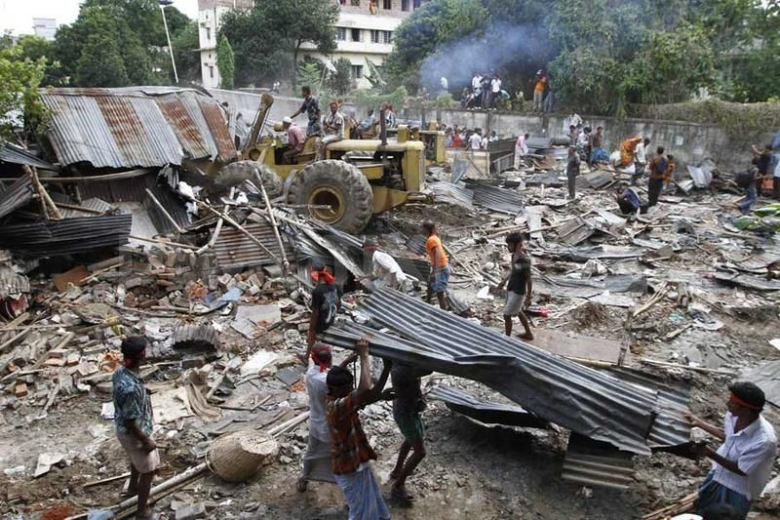
the demolition of slums

Slide 13
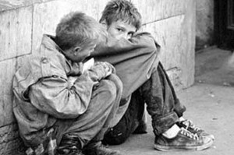
vagrancy

Slide 14
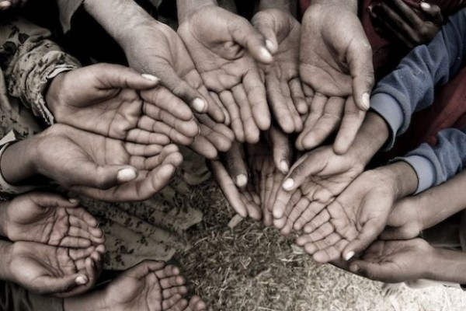
mendicancy

Slide 15
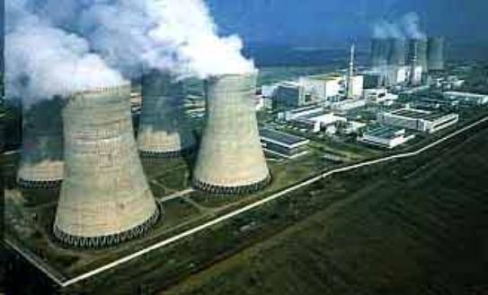
air pollution

Slide 16
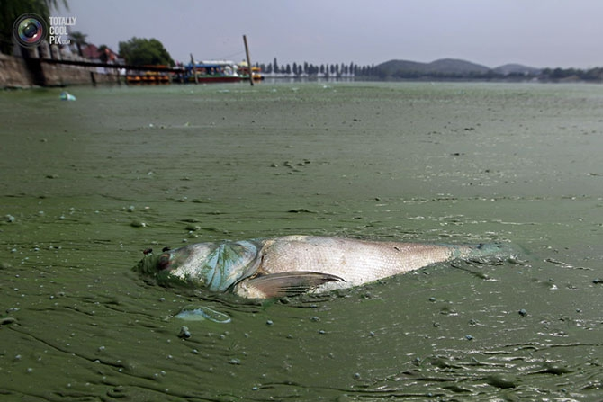
water pollution

Slide 17
Thank you for attention

